Slide 2
Regulations and control
Consumers across the world have great confidence in Danish organic food.
Many rules and regulations govern all aspects of food production.
Rules and regulations are monitored by meticulous government control.
Focus on food safety and traceability.
Organic control from farm to fork.
Denmark was the first country in the world to establish government organic control in 1987.
Yearly physical inspections of all organic farms and companies.

Slide 3
Organic food labels
Organic state-authorized label certifying that the product has been controlled by the Danish food authorities
Mandatory label on all organic products sold in the EU
Danish certification system for large-scale kitchens (restaurants, school kitchens, catering etc.) indicating the percentage of organic raw material used in the kitchen

Slide 4
Paving the way to success – Cooperation
Cooperation is the key driver behind organic sales growth in Denmark.
Close collaboration on organic market development.
Cooperation with all supermarkets at strategic level.
Support to supermarkets in their expansion of organic product lines.
Courses for small organic companies in their collaboration with retail and foodservice sectors.
Advisory service on product development.
Motivating consumers – 80% of Danes purchase organic products – more than 50% buy organic food every week.

Slide 5
Paving the way to success – policy development
Danish organic policy is a catalyst for organic innovation and growth.
Involvement of many stakeholders in political policy development.
Interaction between organic farmes and food companies, consumers, the labour market and environmental and farm organisations in the creation of organic food policy in Denmark.
Organic farming as a tool in broad national policies for the protection of nature, drinking water supply, climate, green growth and rural development.
Push and pull strategy. ”Pull” from the market – ”push” towards the farmers.
Funding of organic development activities in the Fund for Organic Agriculture.

Slide 6
Paving the way to success - Organic research
The development of organic production is based on knowledge and innovation.
Denmark has a strong research tradition in organic farming and food systems.
Organic research supports development of new solutions and new knowledge throughout the supply chain.
ICROFS – International Centre for Research in Organic Food Systems – coordinates the research.
Stakeholder driven research – scientists, practitioners and advisers work together.
Short pathway from new knowledge to practical implementation on farms and at companies.
More than 20 years of targeted research has contributed to the success of organic production in Denmark.

Slide 7
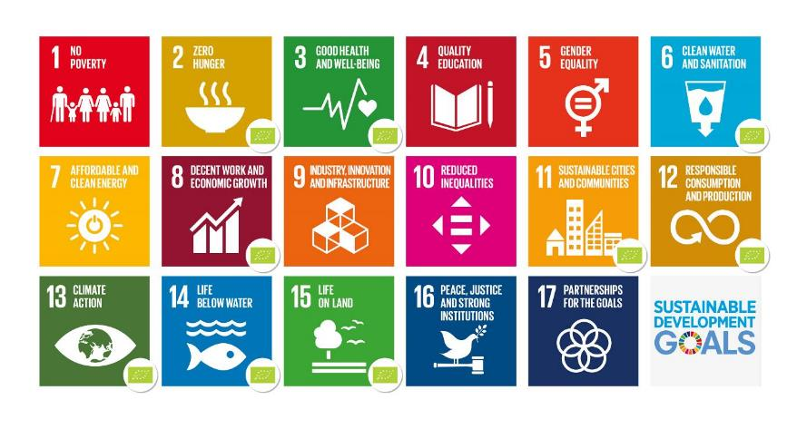
Organic food production and its contribution to un global sustainable development goals

Slide 8
The organic Market

Slide 9
Organic share of the retail market and online SALES

Slide 10
Distribution of organic sales in Denmark 2017
Total sales estimated at DKK 14.0 billion ~ EUR 1.88 billion
* Food markets, farm shops, etc.

Slide 11
2018

Slide 12
General reasons for buying organic food
Safe, healthy and natural food – without synthetic flavourings, colorants and sweeteners. GMOs are prohibited.
Good animal welfare - natural behavior with access to outdoor areas.
Protection of the environment and drinking water – chemical pesticides are prohibited.
Strong focus on sustainability.
High consumer confidence in organic food due to state certification system.
Food trends: local, healthy & natural, and ‘easy-to-make’.

Slide 14
organic market shares on selected products
Product | Share | Product | Share
Oatmeal | 52.3 % | Orange | 27.7 %
Carrots | 42.3 % | Tomatoes | 14,0 %
Eggs | 32.6 % | Beef | 8.6 %
Milk, liquid | 31.6 % | Coffee | 7.0 %
Bananas | 30.6 % | Chicken | 4.1 %
Wheat flour | 30.1 % | Pork | 3.5 %
Source: GfK ConsumerScan, 2017

Slide 15
HIGH ORGANIC CONSUMPTION IN DENMARK
Denmark has the highest market share of organic food and beverages in the world. In 2017, the organic market share reached about 13.3%.
Per capita consumption of organic food was DKK 2,500 in 2017 ~ EUR 335.
Organic sales have grown every year in the past decade. Growth rate in retail was 14% in 2017.
93% of all Danes occasionally buy organic products.
51.4% of all Danes bought organic food every single week in 2017.

Slide 16
FOOD SERVICE SECTOR

Slide 17
SAle of organic products to food service in 2017 – by customer groups

Slide 18
SALE OF ORGANIC PRODUCTS TO FOOD SERVICE
Source: Denmark Statistics

Slide 19
THE ORGANIC CUISINE LABELS (‘eating out labels‘)
Danish certification system for large-scale kitchens (restaurants, school kitchens, catering etc.)
Share of organic raw material used in the kitchen, measured by cost or weight:
Gold Silver Bronze
16%
37%
47%
As at February 2019, a total of 2,655 organic eateries have the Organic Cuisine Label

Slide 20
DEVELOPMENT IN THE NUMBER OF ORGANIC CUISINE LABELS

Slide 21
Organics in the food service sector
EUR 268 million in 2017 = growth of 20%
Organic marked share of almost 10%
Expected growth of 15-20% in 2018
Continued growth in 2019-2020 – however the growth rate is influenced by political objectives and trends in the private food service sector.

Slide 22
Organics and Out-of-home consumption
Public sector kitchens and private canteens have been the drivers behind the development.
Today, the hotel and catering industry currently accounts for half the organic consumption in the food service sector.
Reasons for success: Political visions and Actions Plans.
The succes of organics in the food service sector is largely due to close interaction between a visionary organic policy and allocation of funding for training and information activities in the sector.
60% organics in public sector kitchens.
Mobilising the wholesalers.

Slide 23
organic food within the same budget framework
Training of kitchen staff.
More focus on seasonal vegetables.
Cooking from scratch instead of semi-finished products.
Less meat.
Focus on reduced food waste.

Slide 24
Gastronomy and organic production
Organic food plays an important role in Danish gastronomy.
New Nordic cuisine philosophy set the standards.
Use of natural, locally sourced and seasonal raw materials.
The number of Michelin stars awarded Danish restaurants grew from 12 in 2010 to 33 in 2019.
Organic producers supply a great part of the raw materials to the star chefs.

Slide 25
Trade – Import Export

Slide 26
Organic TRADE - imports and exports
Source: Statistics Denmark

Slide 27
DANISH EXPORT OF ORGANIC GOODS
Source: Statistics Denmark
* Mainly milk powder and baby food but also sauces, dressing, pastas, etc.

Slide 28
DANISH ORGANIC EXPORTS – BY COUNTRY

Slide 29
ORGANIC FARMERS AND THEIR PRODUCTION

Slide 30
THE ORGANIC FARMLAND IN DENMARK
Source: Statistics Denmark.

Slide 31
Distribution of organic land area – by sector
Source: Calculations based on figures from Statistics Denmark

Slide 32
Organic share of total agricultural production, 2017
Source: Calculations based on figures from Statistics Denmark

Slide 33
The organic farmers
10 % of Danish farms are organic. They cultivate 11% of the agricultural land in Denmark.
They produce good healthy raw materials with the utmost care for the environment, biodiversity and animal welfare.
All farmers receive 3-5 years of specialist agricultural training.
Some organic farms are highly specialised – others produce a diverse range of product for direct sales.
The specialised farmers focus an either production of vegetables, cattle, pigs or poultry.
Focus is on developing and improving their products and yields through sound organic practice.
Organic farmers have strong focus on sustainable production and on how sustainability on farms can be improved.

Slide 34
Organic advice for farmers
Long tradition for professional advice to improve farmers’ production.
Impartial local agricultural advisory services.
Specialists in organic production advice farmers in crop production, livestock farming, nature conservation, etc.
SEGES – the national agricultural knowledge center - supports the advisers.
SEGES – a link between research and local advice.
New knowledge must be practically viable for farmers.

Slide 35
Organic Farming – plant production
Chemical plant protection and synthetic fertilisers are not allowed.
Nutrients provided by legumes and recycling of organic materials as crop residues and livestock manures.
Enhances soil life and natural soil fertility.
Contributes to a high level of biodiversity and the preservation of species and natural habitats.
Contributes to the protection of the environment.
The yield from organic fields is typically 10-30% lower compared to conventional plant production.

Slide 36
Animal welfare IN organic Milk and beef production
Good conditions for natural behaviour.
Access to pasture from 15th April to 1th November.
Ample space in their housing units.
Winter-housing system that provides freedom of movement .
Feed must be 100% organic with a lot of roughage.
Use of antibiotics and other drugs is severely restricted.
If treated with veterinary medicine - the withdrawal period is twice as long as the non-organic withdrawal period.
Cows are raised without the use of hormones.

Slide 37
PRODUCTION OF ORGANIC MILK, 2007 – 2017
Source: Statistics Denmark

Slide 38
Animal welfare IN PIG Production
Good conditions for natural behaviour.
Access to grassland or outdoor areas.
Ample space in their housing units.
No tail docking.
In Denmark, sows farrow in an outdoor hut with access to pasture.
100% organic feed in Denmark.
Plenty of roughage, which benefits the pigs’ digestion.
Use of antibiotics and other drugs is severely restricted.
If treated with veterinary medicine - the withdrawal period is twice as long as the non-organic withdrawal period.
Organic pigs are raised without the use of hormones.

Slide 39
PRODUCTION OF ORGANIC PORK 2007- 2017
Source: The Danish Agricultural Agency

Slide 40
Animal welfare in organic egg Production
Good conditions for natural behaviour.
Access to outdoor areas. Outdoor areas have to be covered with vegetation.
The minimum outdoor stocking density is 4 m2/hen.
Indoor stocking density is maximum 6 hens/m2.
The buiding must have natural day-light and a resting period of at least 8 hours is required.
Organic feed with a lot of roughage.
Access to perches and to areas for dust bathing and scratching.
Beak trimming is not allowed.
Use of antibiotics and other drugs is severely restricted.

Slide 41
PRODUCTION OF ORGANIC EGGS, 2007 – 2017
Source: Statistics Denmark

Slide 42
Animal welfare in organic poultry Production
Slow-growing breeds.
Good conditions for natural behaviour.
Access to outdoor areas. Outdoor areas have to be covered with vegetation.
The minimum outdoor stocking density is 4 m2/boiler
Indoor stocking density is maximum 10 boilers/m2
The building must have natural day-light and a resting period of at least 8 hours is required.
Access to areas for dust bathing and scratching.
Organic feed with a lot of roughage.
Beak trimming is not allowed.
Use of antibiotics and other drugs is severely restricted.

